Slide 1
Neural Network &Deep Learning Journal
Securing the Internet of Vehicles: A Deep Learning-Based
Classification Framework
Author : Chamola, and F. R.Yu
Year: 09 feb 2021
Srinidhi Radharapu
700757822

Slide 2
Motivation
The INTERNET of Vehicles (IoV) is a new paradigm of vehicular networks inspired by the adoption of the Internet of Things (IoT) in Vehicular Ad-hoc Networks (VANETs). IoV is expected to usher in an era of connected vehicles, which use their On-Board Units (OBUs) to communicate with each other and with the road-side infrastructure generally called Roadside Units (RSUs).

Slide 3
Motivation
Nevertheless, the growing number of Vehicle to Vehicle (V2V) and Vehicle to Infrastructure (V2I) communication links in these next-generation vehicular networks also increases the potential attack surfaces in the networks.
And with the increasing number of attack surfaces, there is a higher possibility of cybersecurity attacks. Thus, there is a greater need for developing security solutions for these next-generation vehicular networks such as IoV networks

Slide 4
Problem Statement
cybersecurity challenges, including vulnerabilities to malicious attacks, unauthorized access, and data breaches.
Securing IoV systems is paramount to safeguarding vehicle operations, user privacy, and ensuring system reliability.

Slide 5
Objectives
Coarse-Grained Classification Method: This approach is a two-class coarse-grained classification method (CGCM) that distinguishes normal vehicle data from misbehavior data. In this approach, the faults and attacks are grouped into a single misbehavior (Faults + Attacks) class. When the input data is passed through the CGCM classifier, every possible fault and attack type data is classified into the misbehavior class, while the normal vehicle data is classified into the normal class.

Slide 6
Objectives
Fine-Grained Classification Method: The second approach is a fine-grained classification method (FGCM) with three predicted classes based on normal vehicle behavior, faulty behavior, or attack behavior. Thus, compared to the first approach this is a more fine-grained classification approach. When the input data is passed through the FGCM classifier, normal vehicle data is classified into normal class, the fault type data into the fault class and the attack type data into the attack class.

Slide 7
Objectives
Deep Learning Models :
Two types of deep neural networks called Long Short-term Memory (LSTM) and CNN are considered in this letter which are the building blocks for the deep learning models which go into the proposed classifiers.
LSTMs are a type of Recurrent Neural Networks (RNNs) which are found to be quite efficient in classifying time series data due to the feedback loops present in their architecture that can remember temporal data. Thus, they find their applications in temporal sequence classification problems such as intrusion detection and speech recognition.

Slide 8
Objectives
CNNs are another type of deep neural networks which work best on visual images. Using an architecture of sliding filters and convolutional input layers, they can identify complex patterns in the input data

Slide 9
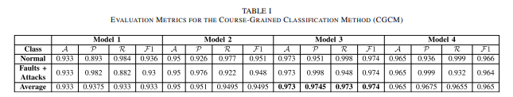
Results

Slide 10
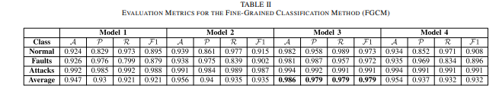
Results

Slide 11
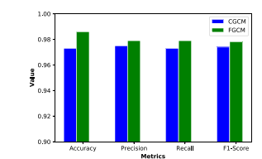
.

Slide 12
Critical analysis
Dynamic Threat Landscape:
Evolving cyber threats demand adaptive security measures to protect against malware, data breaches, and communication vulnerabilities.
Privacy Concerns:
Collection and protection of sensitive data pose challenges in ensuring user privacy and compliance with regulations.
Reliability and Safety:
Security incidents can disrupt vehicle operations and compromise safety-critical functions, necessitating resilient security architectures.

Slide 13
Conclusion
This letter proposed deep learning-based classification approaches for identifying and classifying misbehaving vehicles in the IoV networks. Two classification approaches were considered where one is a coarse-grained classification of normal vehicle data and all possible misbehavior types, the other is a more fine-grained classification to classify the misbehavior.

Slide 14
References
B. Ji, X. Zhang, S. Mumtaz, C. Han, C. Li, H. Wen, and D. Wang, “Survey on the internet of vehicles: Network architectures and applications,” IEEE Communications Standards Magazine, vol. 4, no. 1, pp. 34–41, 2020.
Z. Lu, G. Qu, and Z. Liu, “A survey on recent advances in vehicular network security, trust, and privacy,” IEEE Transactions on Intelligent Transportation Systems, vol. 20, no. 2, pp. 760–776, 2018.
T. Alladi, V. Chamola, B. Sikdar, and K.-K. R. Choo, “Consumer iot: Security vulnerability case studies and solutions,” IEEE Consumer Electronics Magazine, vol. 9, no. 2, pp. 17–25, 2020.
A. K. Sutrala, P. Bagga, A. K. Das, N. Kumar, J. J. Rodrigues, and P. Lorenz, “On the design of conditional privacy preserving batch verification-based authentication scheme for internet of vehicles deployment,” IEEE Transactions on Vehicular Technology, vol. 69, no. 5, pp. 5535–5548, 2020.
G. Bansal, N. Naren, V. Chamola, B. Sikdar, N. Kumar, and M. Guizani, “Lightweight mutual authentication protocol for v2g using physical unclonable function,” IEEE Transactions on Vehicular Technology, 2020.

Slide 15
Thankyou

